Slide 1
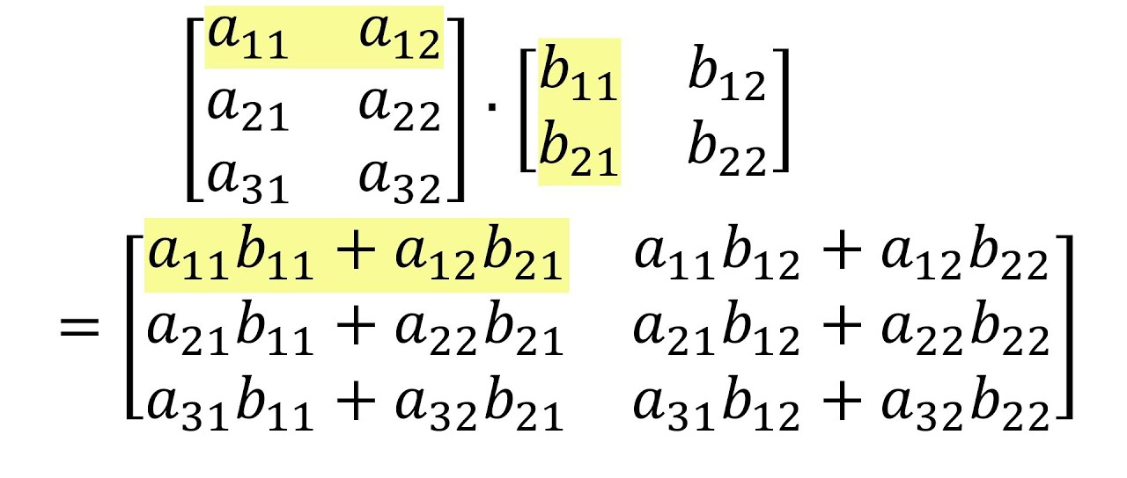
Programming Practice 01
Given two matrices, write a function to multiply them together:
print(mat_mult([[3, 3], [2, 2], [1, 1]],
[[2, 3], [3, 2]])
> [[15, 15], [10, 10], [5, 5]]
NOTE: I thought this was really
tricky and it took me a while!

Slide 2
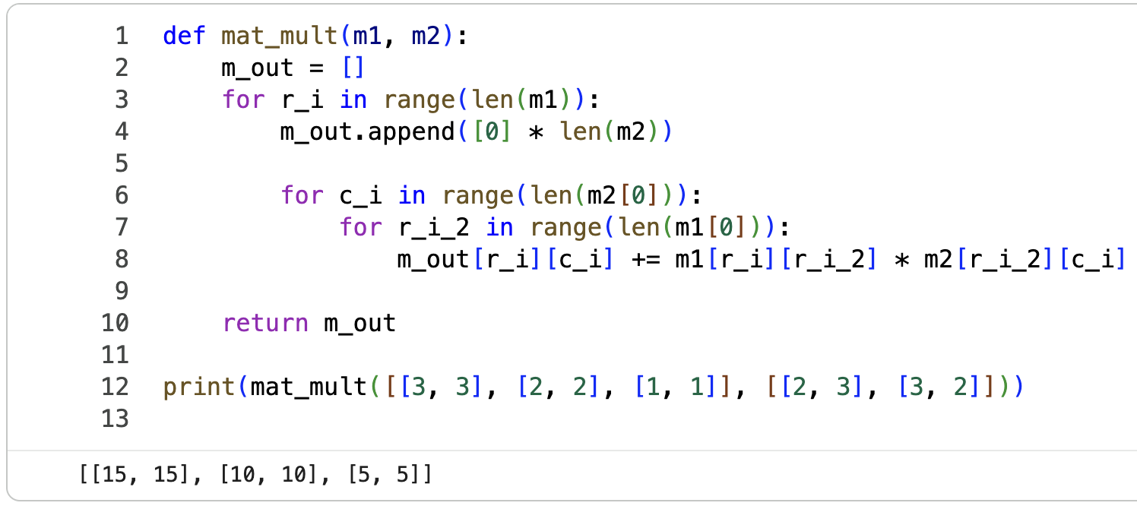
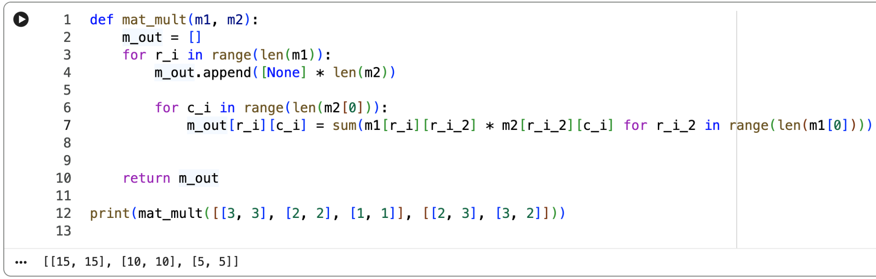
Programming Practice 01 Solution

Slide 3
CSE 10124 Neural Networks

Slide 4
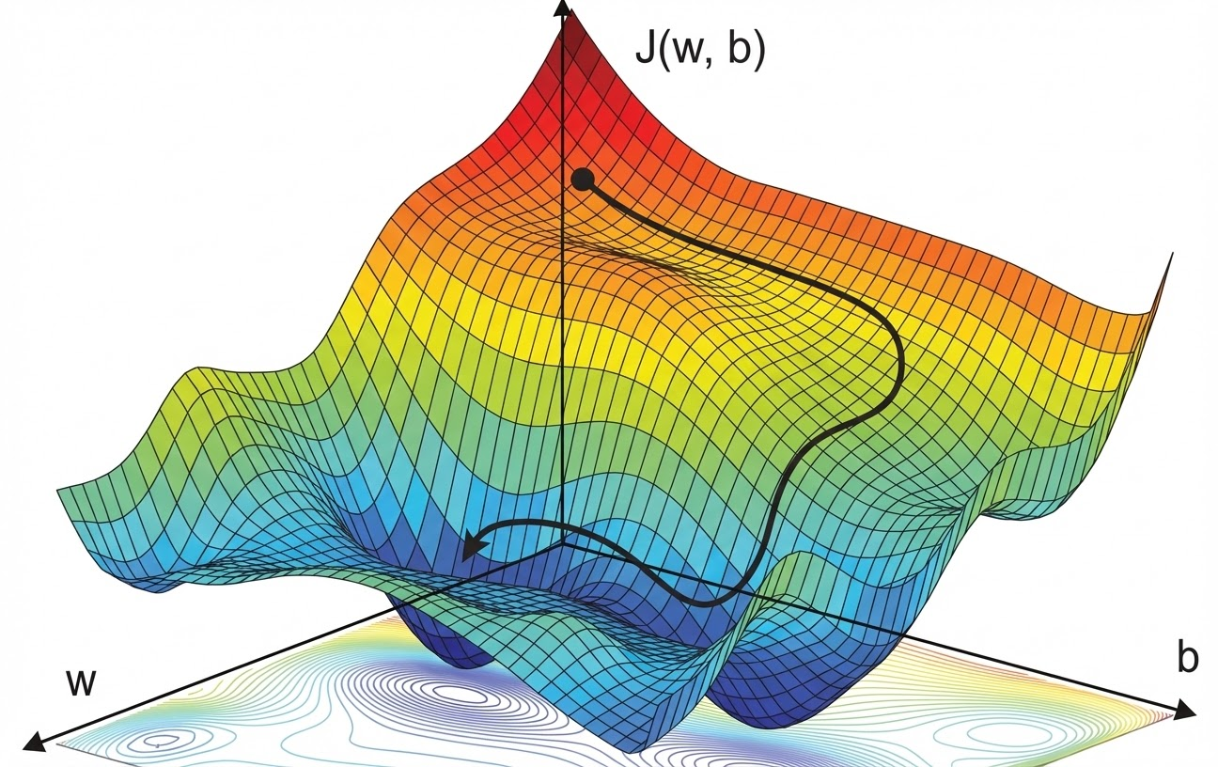
Gradient Descent

Slide 5
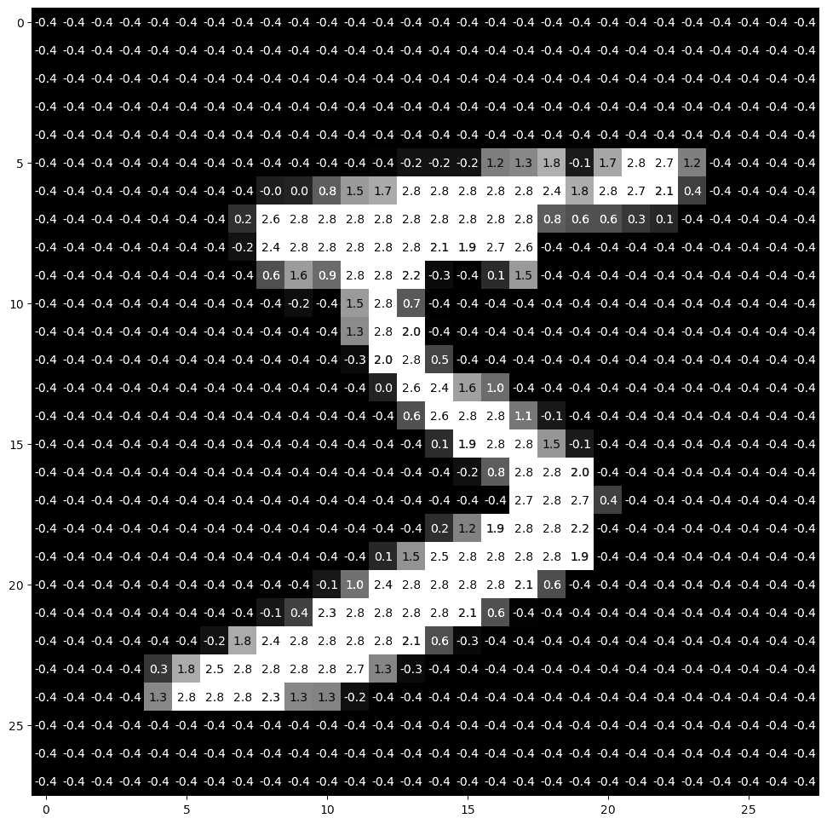
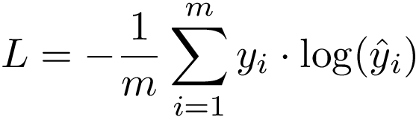
Writing MNIST “Equations”
<
…
…
>
X = <784>
X⍵^{T} + b)
ŷ = X⍵^{T} + b

Slide 6
CIFAR-10

Slide 7
Non-linearity

Slide 8
Activation Functions

Slide 9
Deep Learning

Slide 10
Convolutional Neural Networks

